Slide 1

B.E Project
By
Anamika Sonawane
Anindita Chowdhury

Slide 2
Eye Control System Based on Ameliorated Hough Transform Algorithm

Slide 3
Contents
Introduction
Abstract
Proposed System
Design
Dependencies
Technology Stack
Planning (For Code Development)

Slide 4
Introduction
More than 1 billion persons in the world have some form of disability. This corresponds to about 15% of the world's population.
census 2001 has revealed that over 21 million people in India are suffering from one or the other kind of disability. This is equivalent to 2.1% of the population.
Due to their limb handicap, such vast amount of people cannot enjoy the convenience and entertainment of the ever advancing computer technology.
So, this paper has purpose of meeting the specific needs of these limb disabled people.
Notes:
With purpose of meeting the specific needs of these limb disabled people, in this paper we design an eye control system that might be useful for those limb disabled people with healthy eyes to interact with computers.

Slide 5
Abstract
This paper proposes an eye control system employing eye gaze tracking techniques that might be helpful for those limb disabled people with healthy eyes.
Functionalities -
Moving the mouse with in the screen
Clicking to a button or an application icon

Slide 6
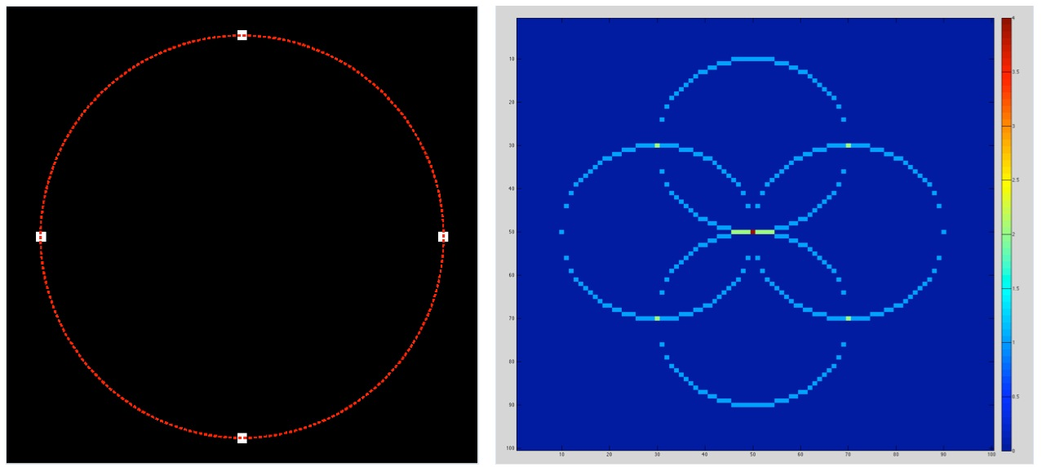
Proposed System
PUPIL LOCALIZATION
The Hough transform is a feature extraction technique used in image analysis, computer vision, and digital image processing.
Circle Hough Transform

Slide 7
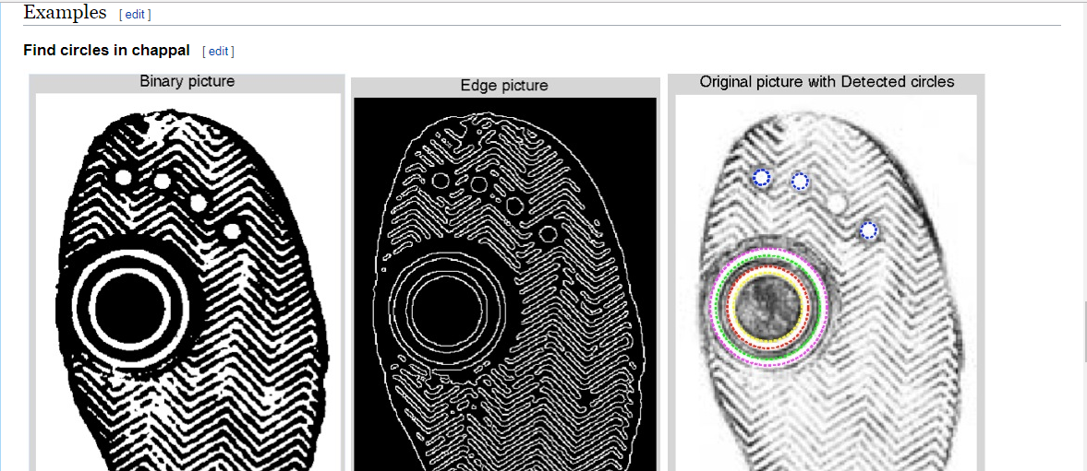

Slide 8
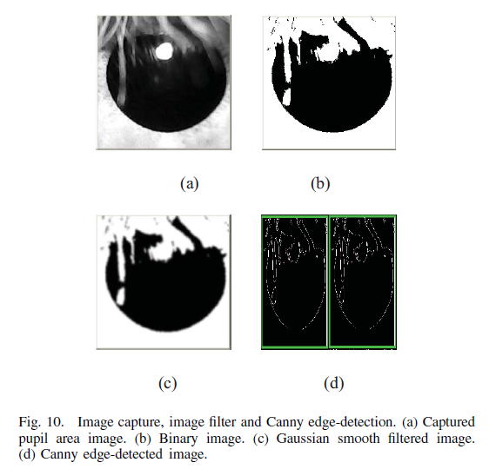

Slide 9
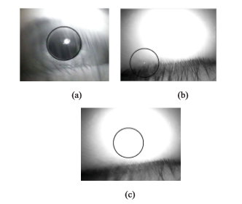
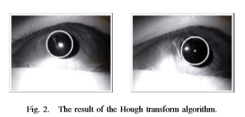

Slide 10
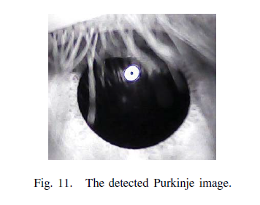
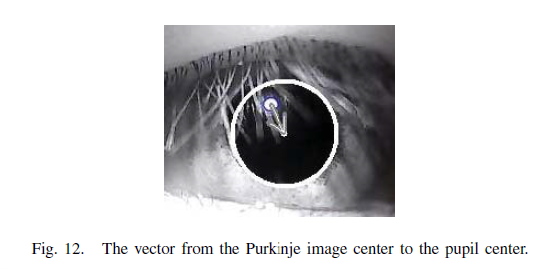
2. GAZE DETECTION
Purkinje images are reflections from light, particularly infrared (IR) light, off the eye. The main target of the system is to obtain a series of vectors from the Purkinje image center to the pupil center as eye-gaze direction parameters
in real time.

Slide 11
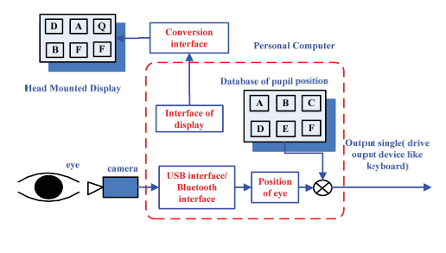
Design
Hardware Requirements
Camera
Computer
Software Components
Hough transform algorithm,
the Purkinje image detection method,
the blink detection method, and
the coordinates transform & calibration method.

Slide 13
Dependencies
The distance between the person and the camera
Duration of blinking

Slide 14
Technology Stack
&
Planning
Scilab
Python
OpenCV

Slide 15

Thank You

